Slide 1

Building APIs with Node and Express
Chapter 1 – Set up

Slide 2
1.1. Building APIs with Node and Express
Set up to Build APIs with node, express, mongoDB and test APIs using Postman
Express Middleware
{
API Implementation code
}
Node JS runtime Software
Database
Mongo Database
No-sql database
API
GET
POST
PUT
DELETE
Postman
to test API
Install Node
Node LTS version
Install Mongo Database
MongoDB
Install Postman
© 2024 Web Age Solutions All rights reserved

Slide 3
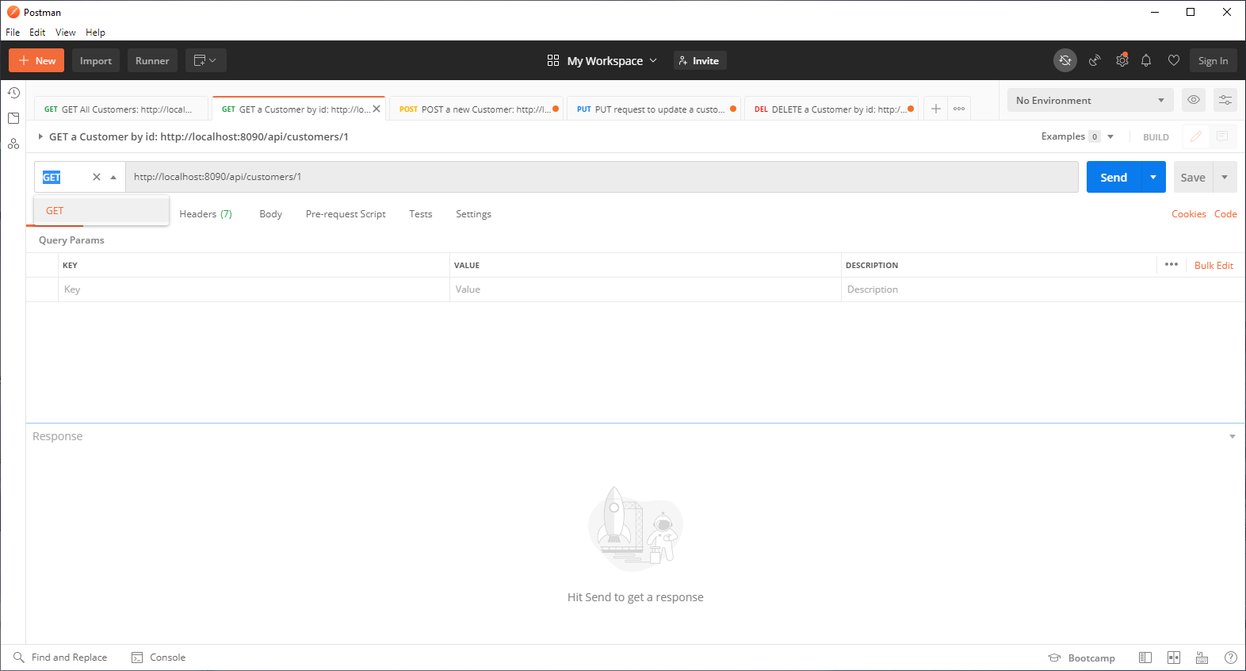
1.2 Postman
Postman is an application that allows the testing of web APIs
https://www.postman.com/
© 2024 Web Age Solutions All rights reserved

Slide 4
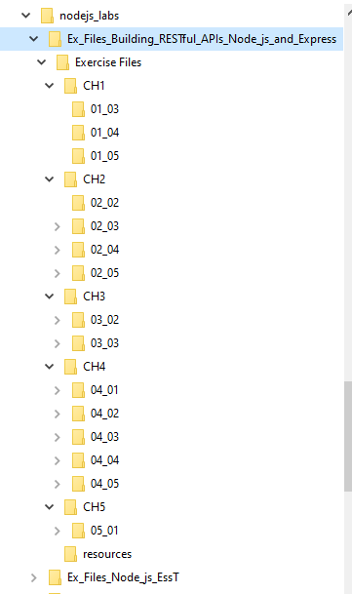
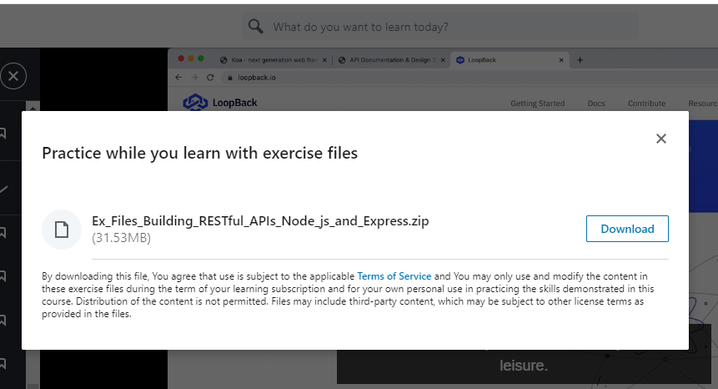
1.3 Exercises and Exercise Files
Use Visual Studio Code for all Hands-on activities
Install it and start VSCode
Download LinkedIn Materials Exercises Files
Ex_Files_Building_RESTful_APIs_Node_js_and_Express
Extract Exercises from Ex_Files_Building_RESTful_APIs_Node_js_and_Express into C:\nodejs_labs

Slide 5
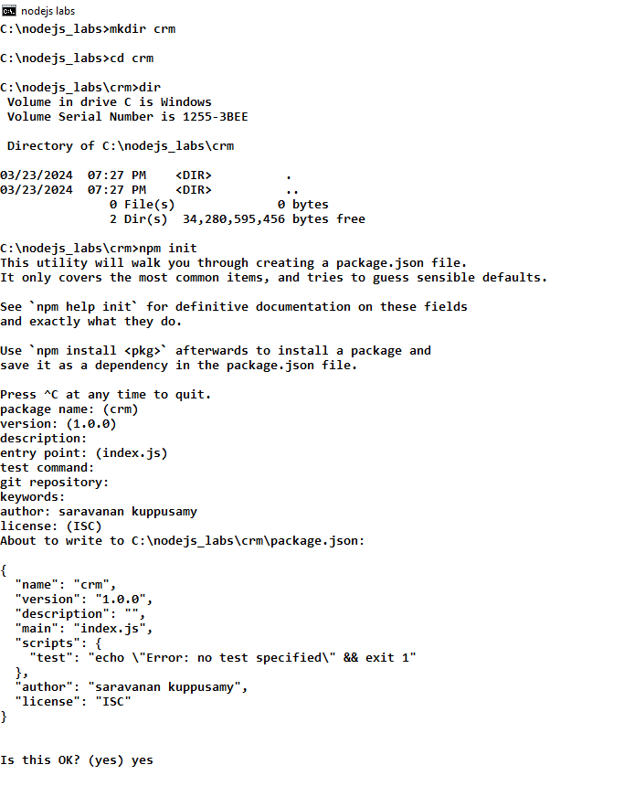
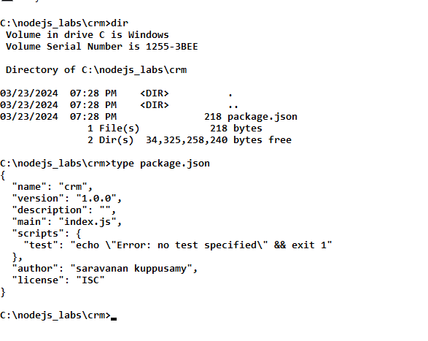
1.4 Install Node and Initialize NPM project
Download and Install Node.js
Use LTS version
We have done this !
Create a Working directory for lab activities
Create a Project and initialize the project using npm init
Open a cmd window, cd to C:\nodejs_labs
cd C:\nodejs_labs
Type the command
npm init
Use the default values for project settings

Slide 6
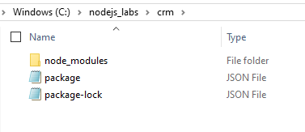
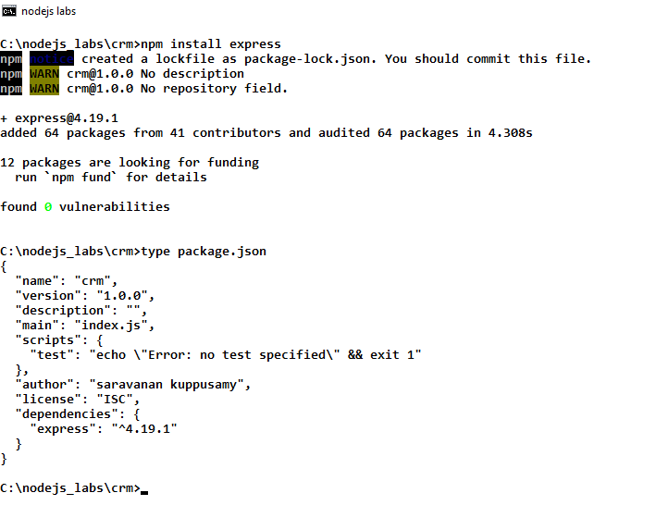
1.5 Install Express
Run the command to install express
npm install express

Slide 7
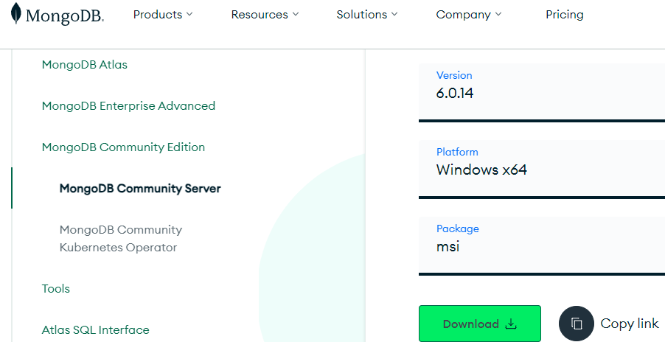
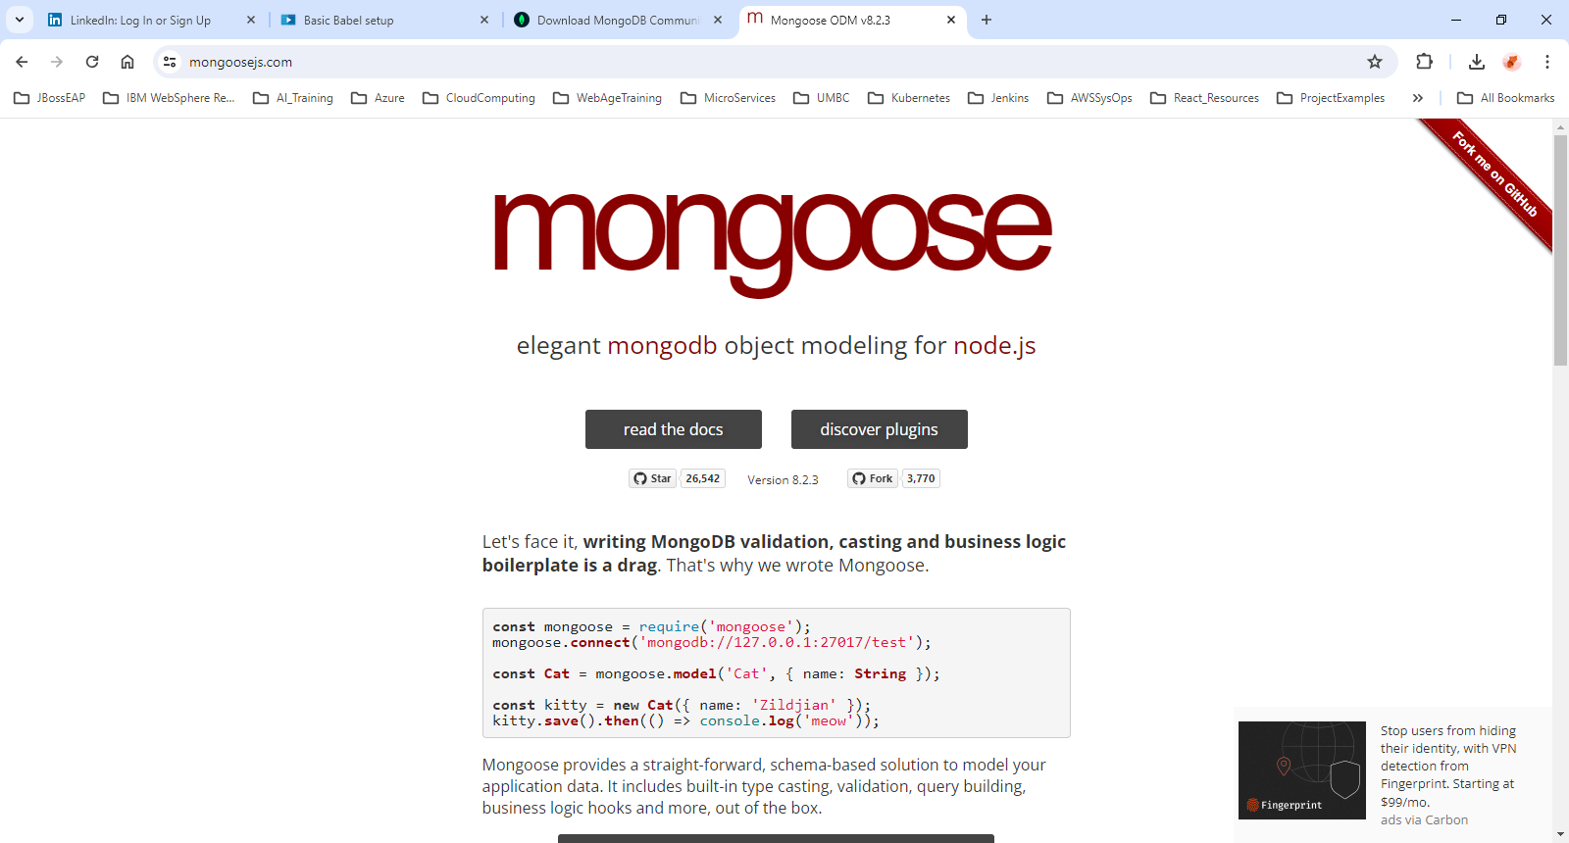
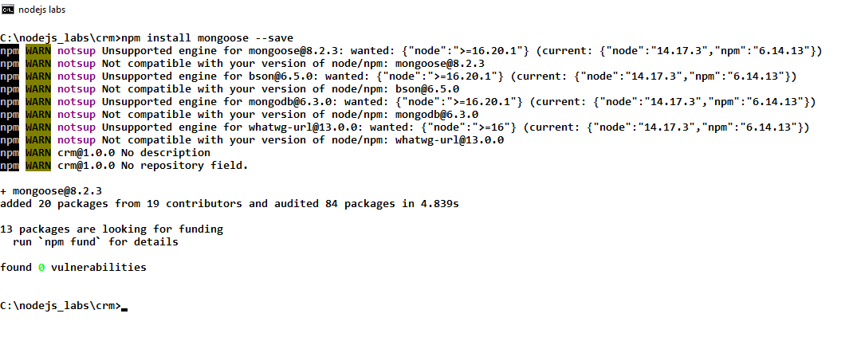
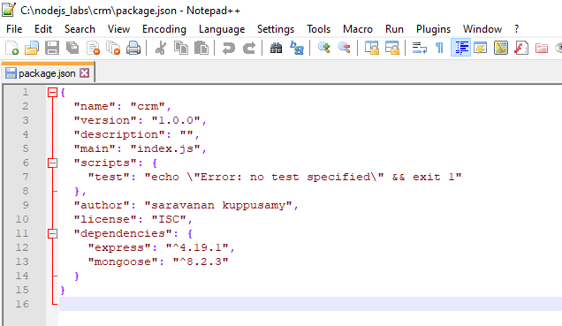
1.6 Install Mongo DB and Mongoose Dependencies
Go to MongoDB site and download MongoDB
Version 6.0.14
Windows x64
Download and Install
Go to mongoosejs.com
Review the docs
Mongoose is a library
Install Mongoose using npm
npm install mongoose --save

Slide 8
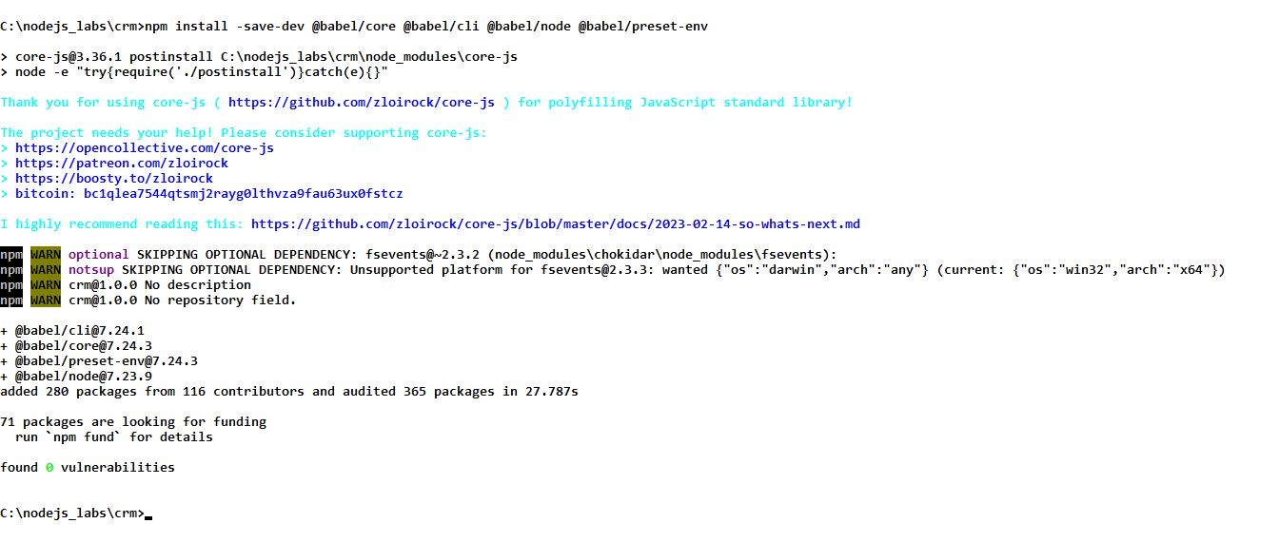
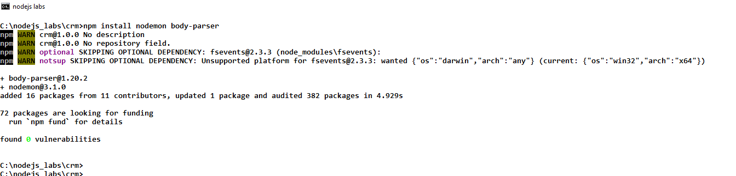
1.7 Basic Babel Setup
Babel is a JavaScript Compiler
https://babeljs.io/
https://babeljs.io/docs/
Install babel using npm
npm install –save-dev @babel/core @babel/cli @babel/node @babel/preset-env
Install nodemon and body-parser using npm
npm install nodemon body-parser
Add a .babelrc
configure

Slide 9
Building APIs with Node and Express
Chapter 2 – Initial Server Build

Slide 10
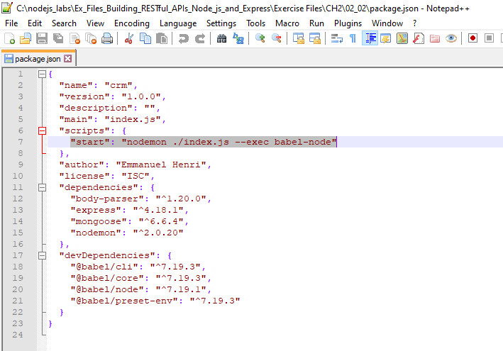
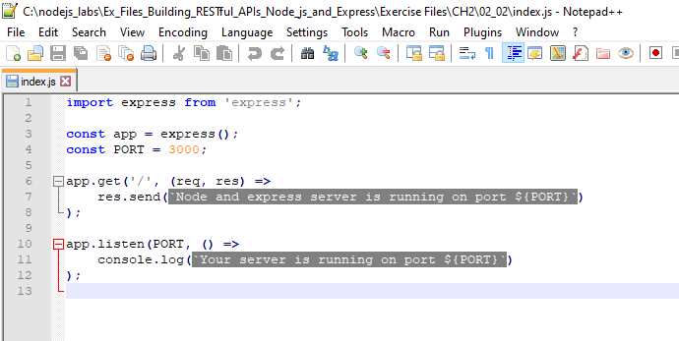
2.1. Initial Server Setup
© 2024 Web Age Solutions All rights reserved

Slide 11
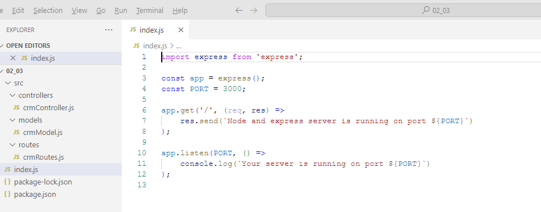
2.2. Initial Server Files and Folders
© 2024 Web Age Solutions All rights reserved

Slide 12
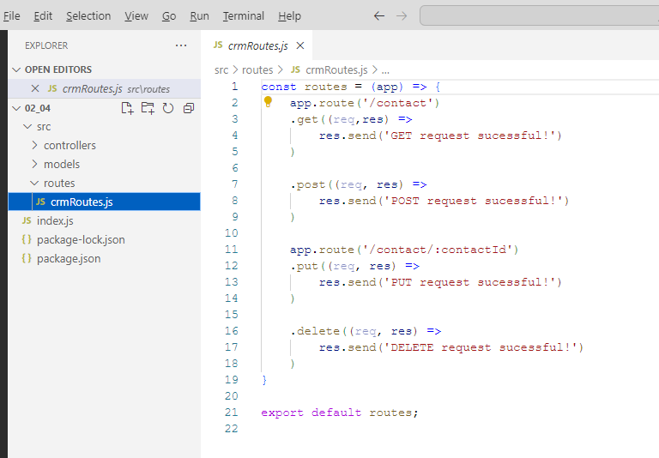
2.3. Basic Routing End Points
© 2024 Web Age Solutions All rights reserved

Slide 13
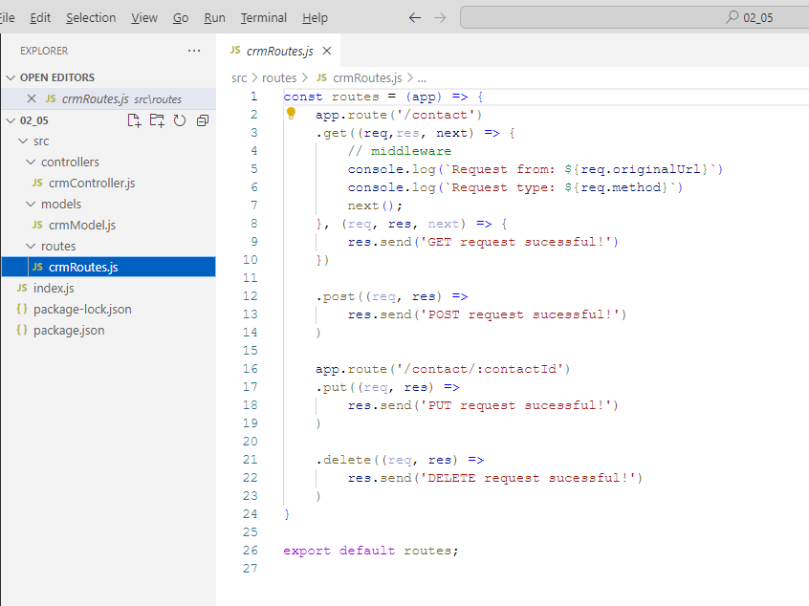
2.4. Basics of Middleware and uses
© 2024 Web Age Solutions All rights reserved

Slide 14
Building APIs with Node and Express
Chapter 3 – Database Setup

Slide 15
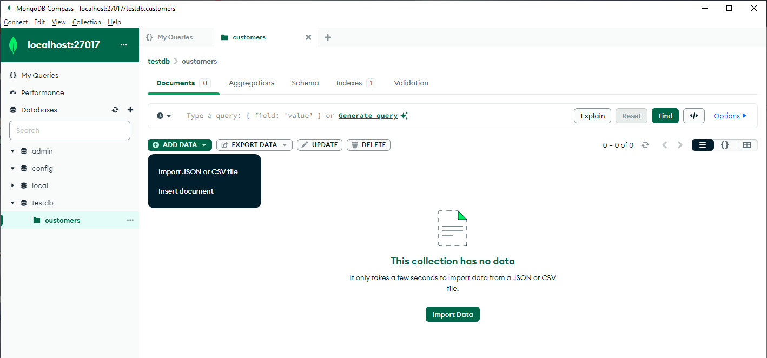
3.1. MongoDB Refresher
MongoDB Overview
Database with collections
Collections contain documents or objects
Each document contains data in key-value pairs format
MongoDB Tools
Robo 3T (used by the LinkedIn course author)
Mongo Compass
© 2024 Web Age Solutions All rights reserved

Slide 16
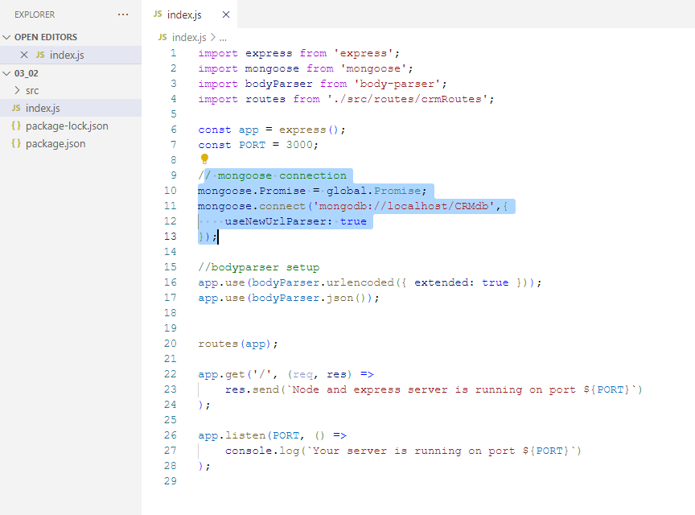
3.2. Database Setup
© 2024 Web Age Solutions All rights reserved

Slide 17
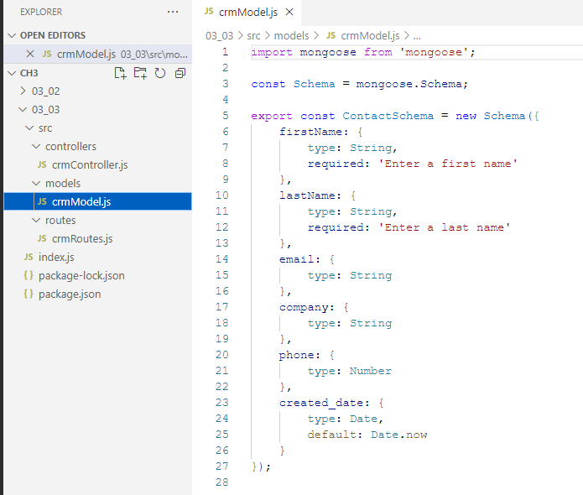
3.2. Database Schema Setup
© 2024 Web Age Solutions All rights reserved

Slide 18
Building APIs with Node and Express
Chapter 4 – CRUD Operations

Slide 19
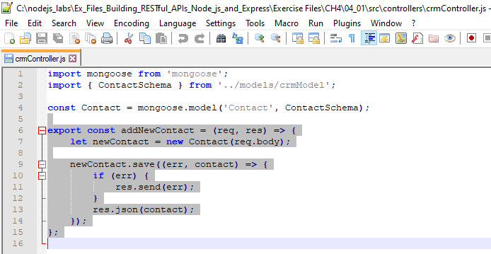
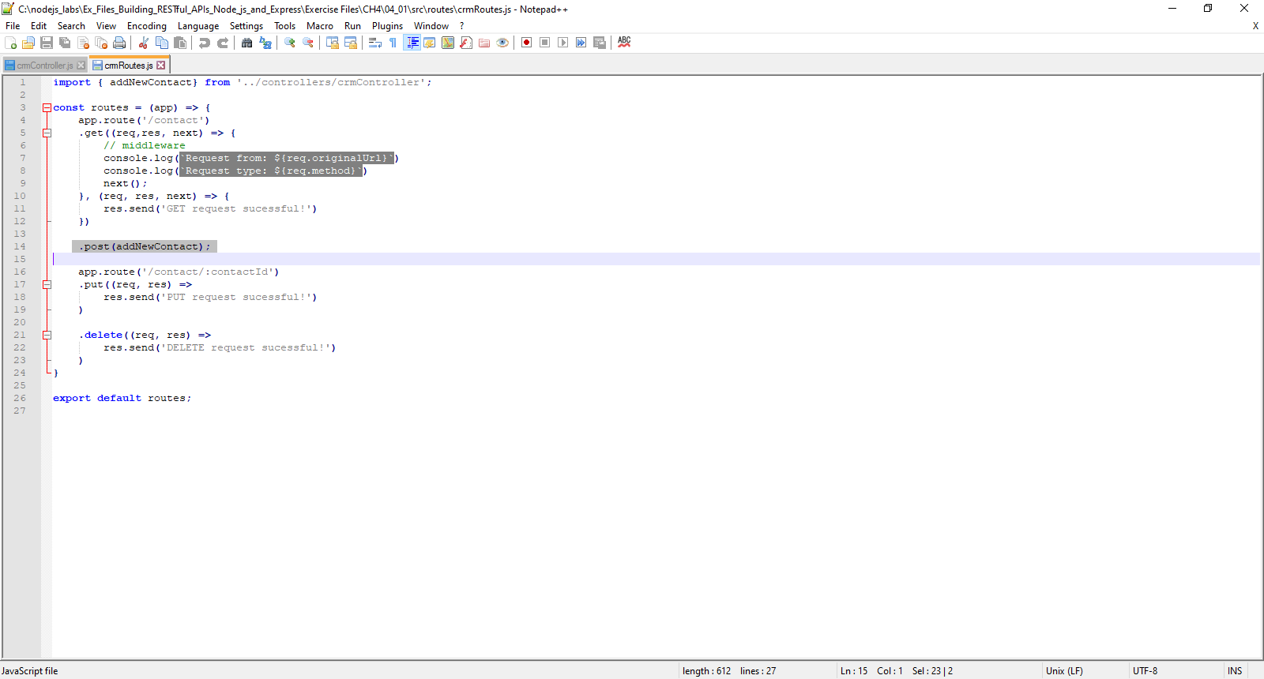
4.1 Create POST endpoint
© 2024 Web Age Solutions All rights reserved

Slide 20
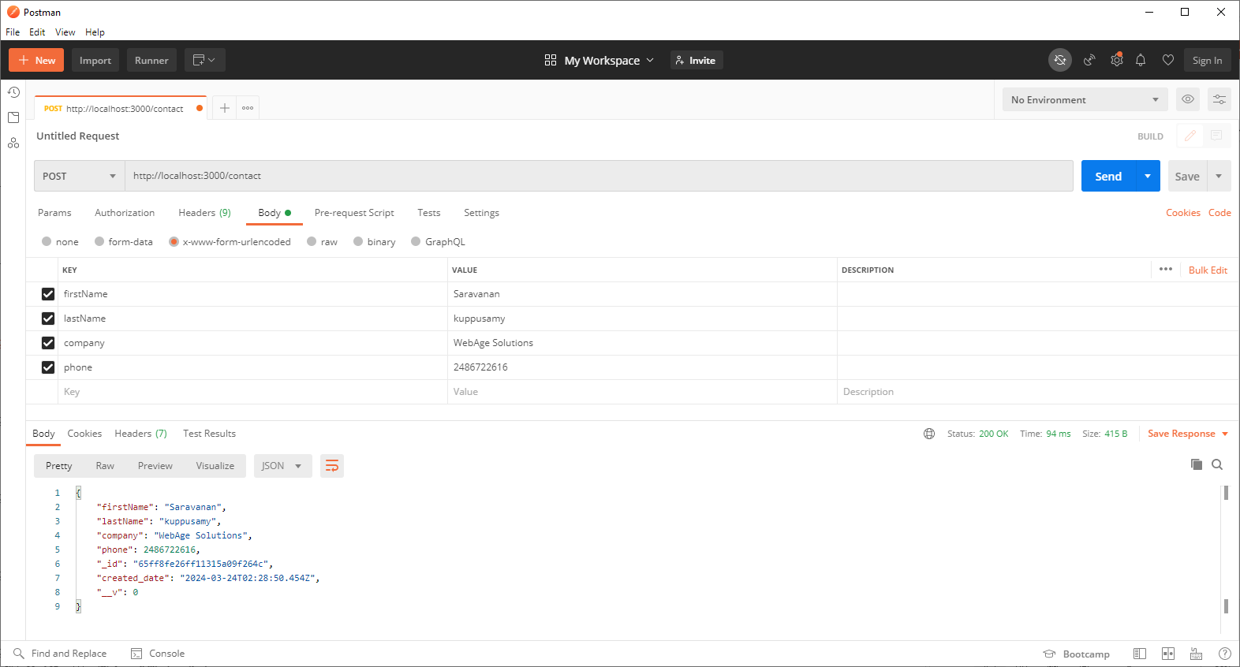
4.2 POST endpoint Test
© 2024 Web Age Solutions All rights reserved

Slide 21
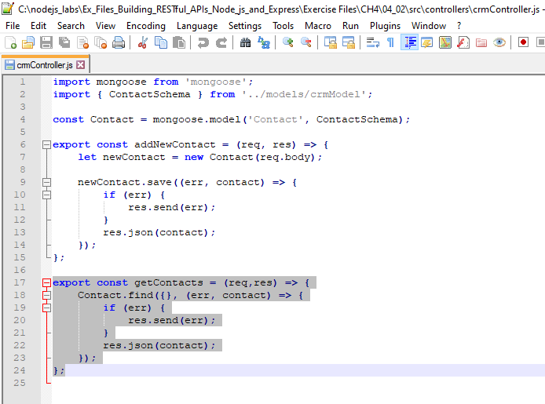
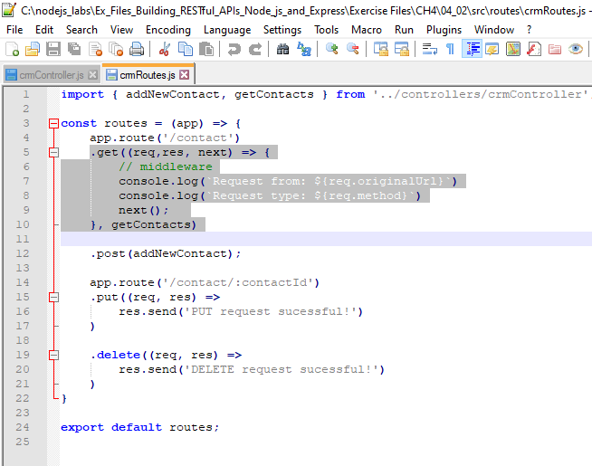
4.3 Create all items GET endpoint
© 2024 Web Age Solutions All rights reserved

Slide 22
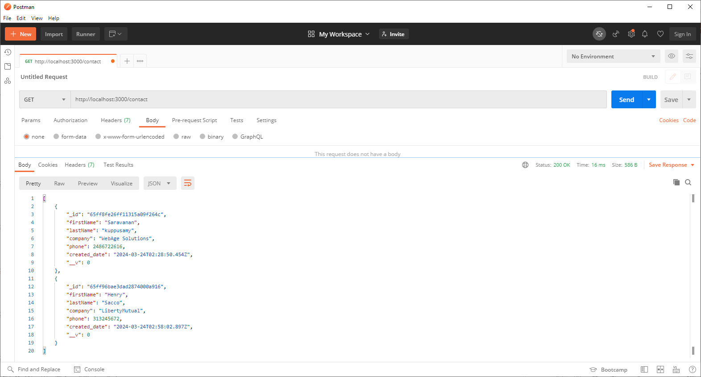
4.4 Postman all items GET endpoint Test
© 2024 Web Age Solutions All rights reserved

Slide 23
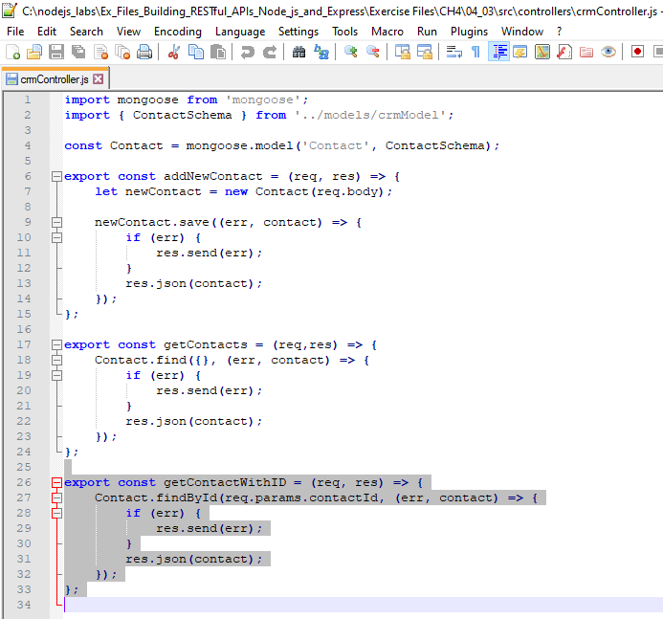
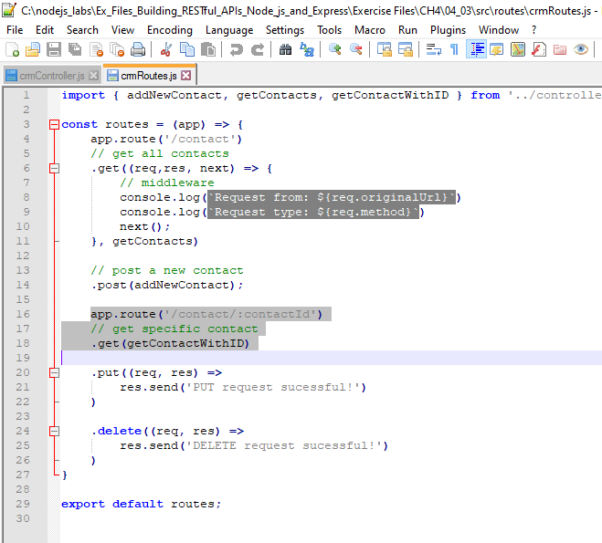
4.5 Create specific ID GET endpoint
© 2024 Web Age Solutions All rights reserved

Slide 24
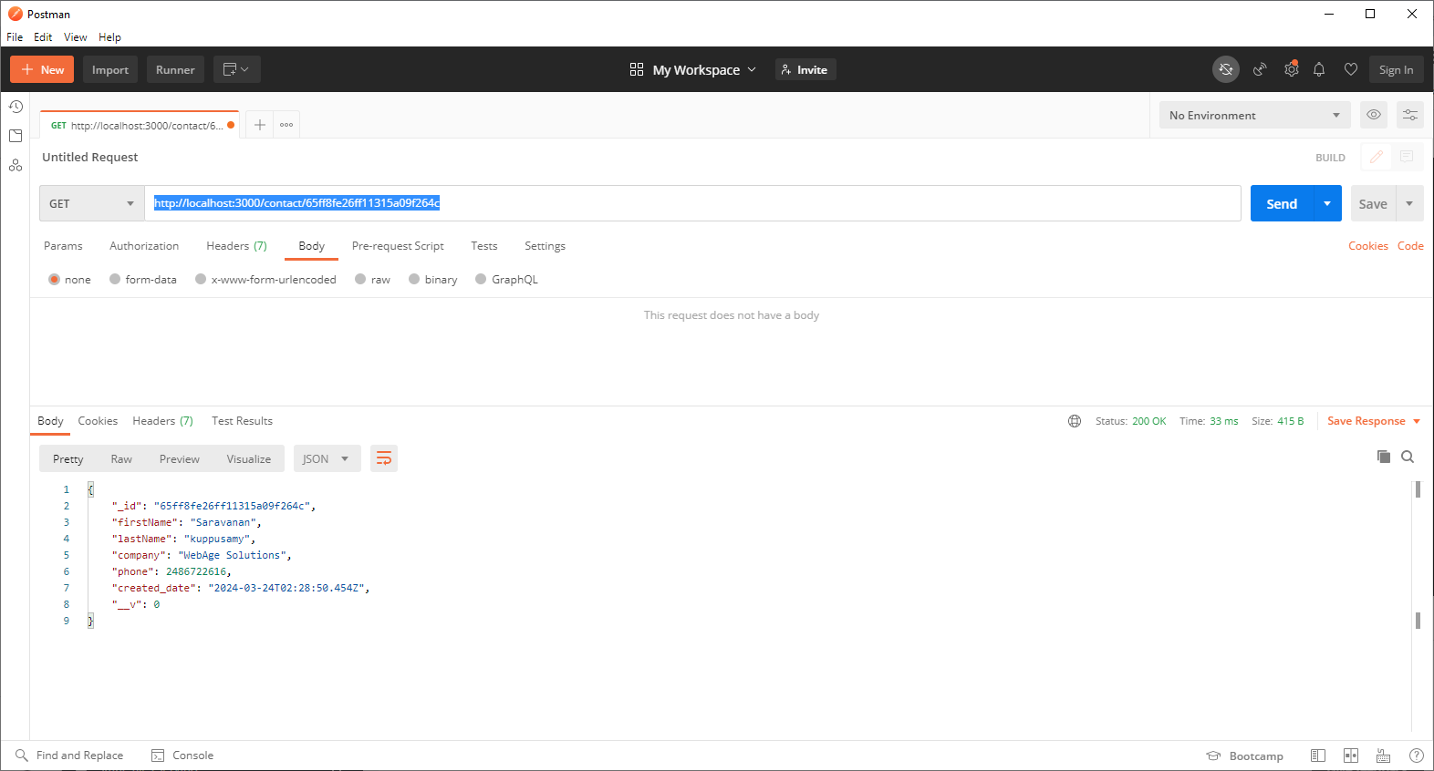
4.6 Postman specific ID GET endpoint Test
© 2024 Web Age Solutions All rights reserved

Slide 25
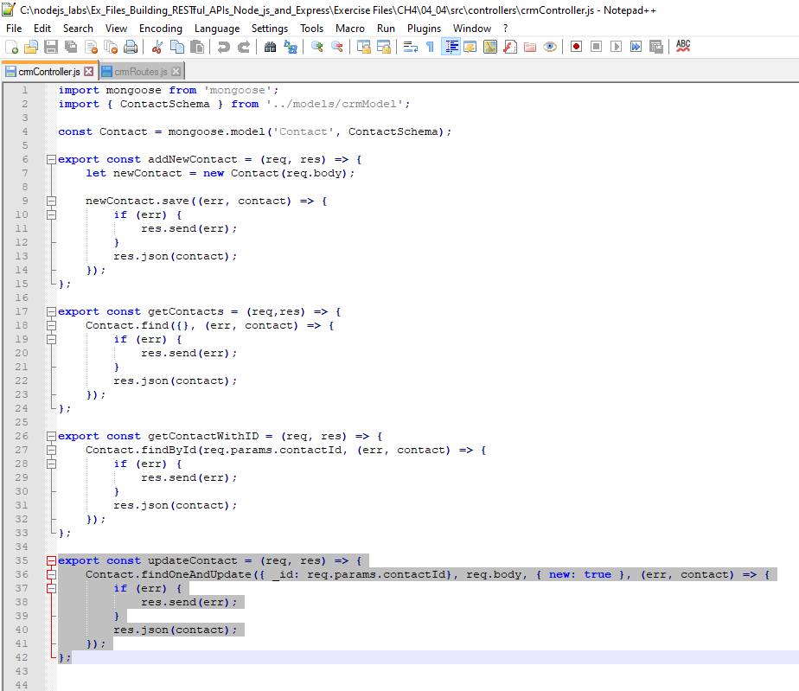
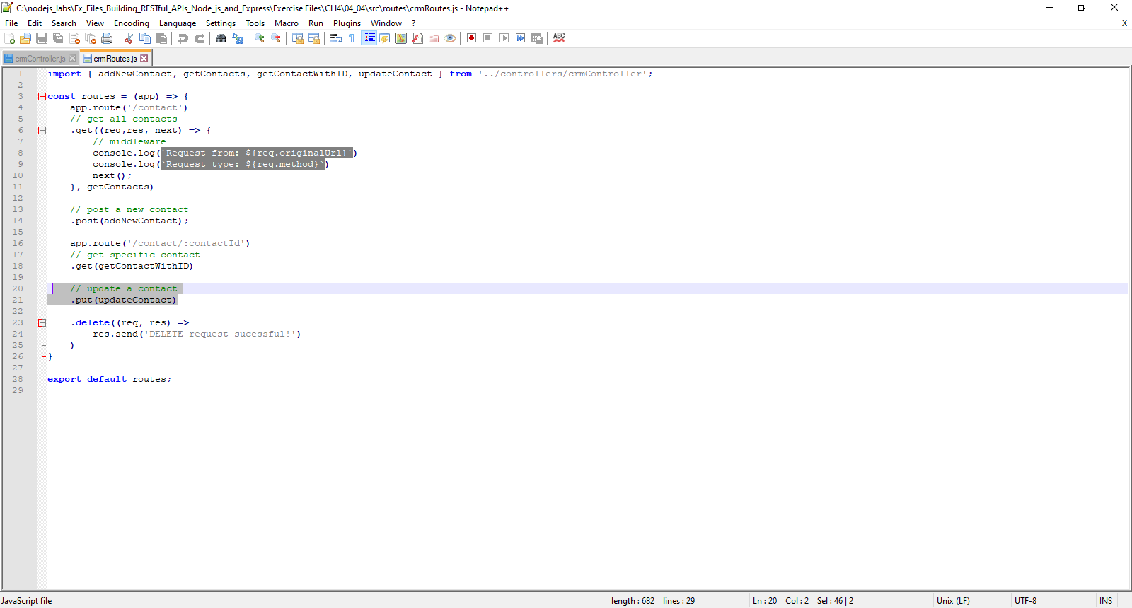
4.7 Create PUT endpoint
© 2024 Web Age Solutions All rights reserved

Slide 26

4.8 Postman PUT endpoint Test
© 2024 Web Age Solutions All rights reserved

Slide 27
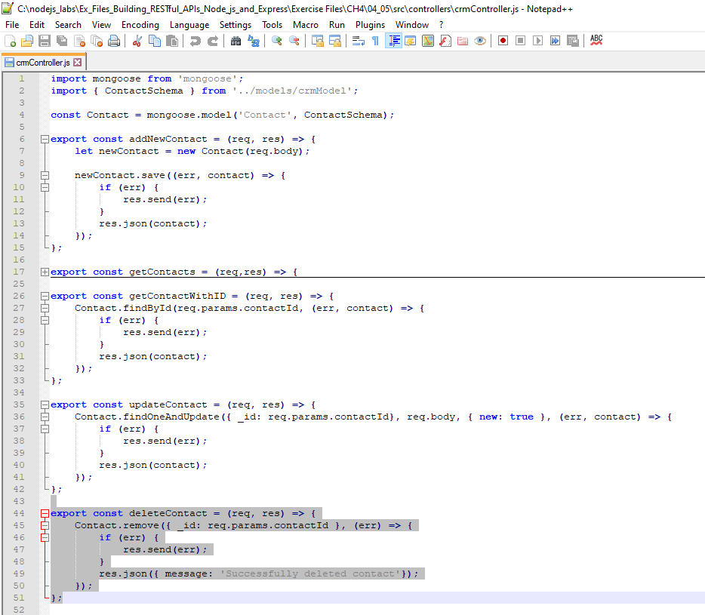
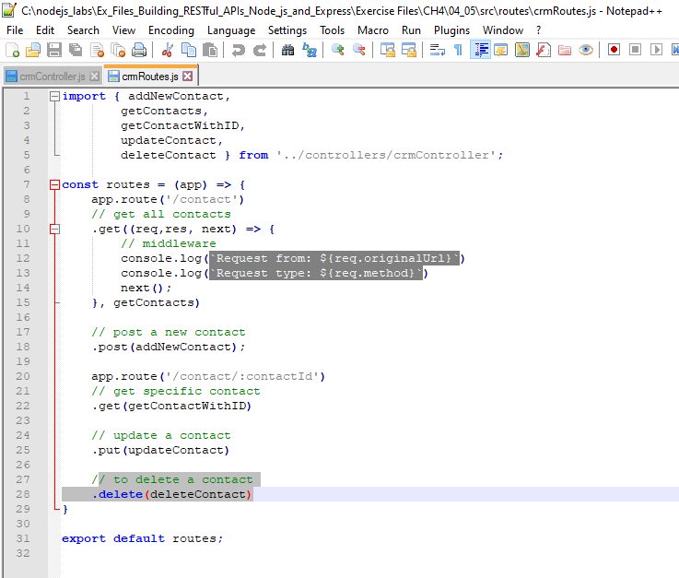
4.9 Create DELETE endpoint
© 2024 Web Age Solutions All rights reserved

Slide 28
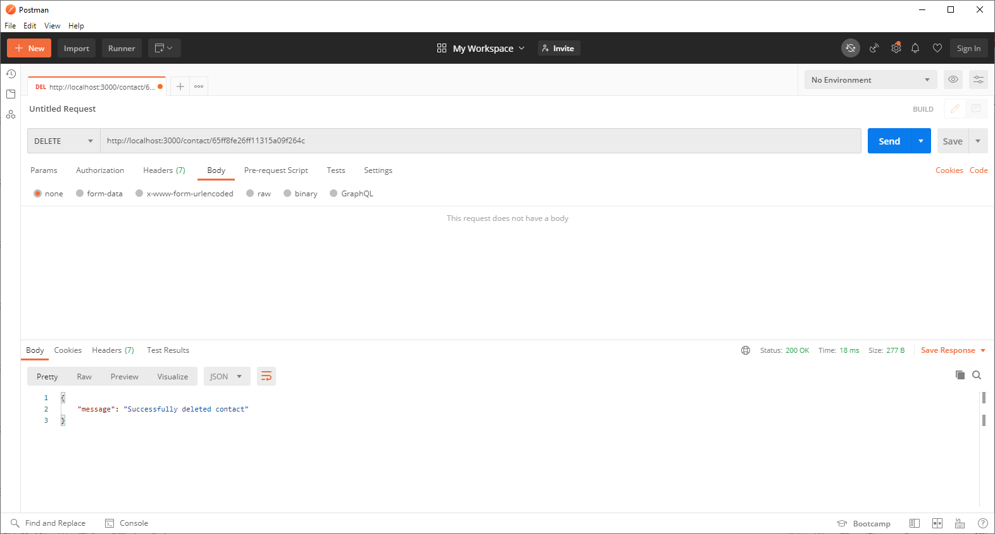
4.10 Postman DELETE endpoint Test
© 2024 Web Age Solutions All rights reserved

Slide 29
Building APIs with Node and Express
Chapter 5 – Other API Options

Slide 30
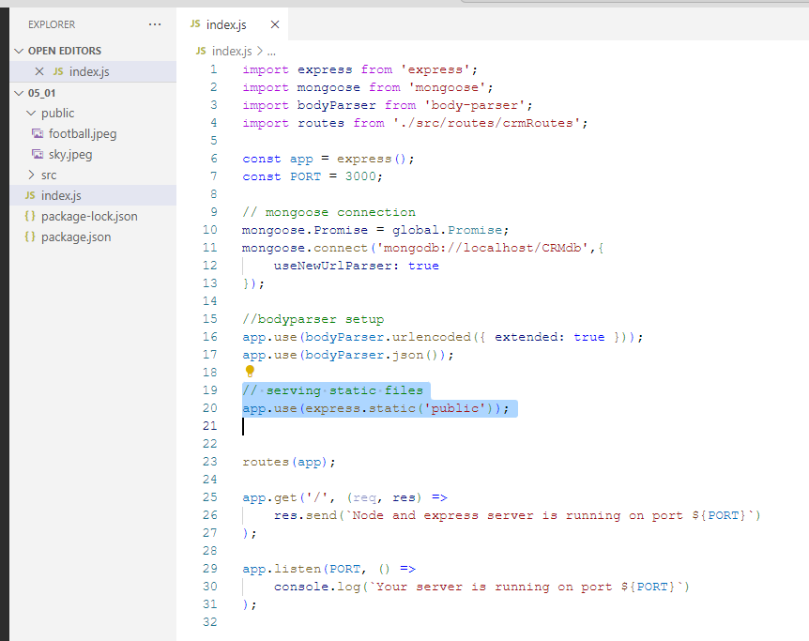
5.1 Static File Serving
© 2024 Web Age Solutions All rights reserved

Slide 31
WA3476 Liberty FSE Phase 3 Chapter 4
Chapter 4 - Express Middleware........................................................................................31
4.1 Introduction to Express Middleware......................................................................31
4.2 Writing a Middleware Function.............................................................................31
4.3 Binding to a Path....................................................................................................32
4.4 Order of Execution.................................................................................................33
4.5 Raising Error..........................................................................................................34
4.6 Handling Error.......................................................................................................34
4.7 Serving Static Files................................................................................................35
4.8 Handling POST Request Body...............................................................................36
4.9 Enable Response Compression..............................................................................37
4.10 Summary..............................................................................................................37
© 2024 Web Age Solutions All rights reserved

